Slide 1
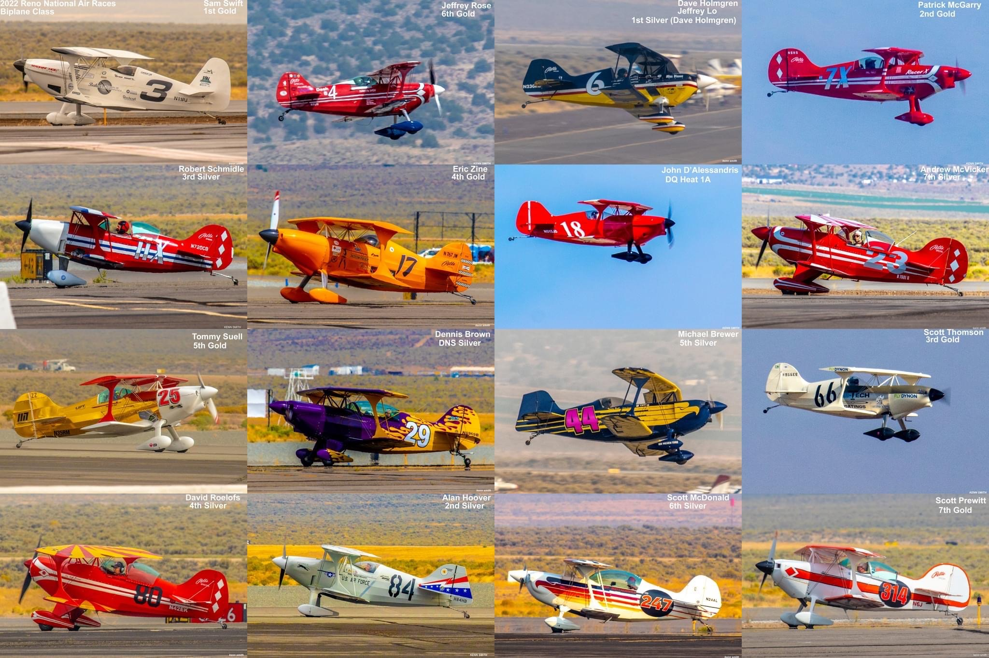
Biplane Air Racing Class Pylon Racing Seminar
Roswell, New Mexico
May 2025
Photo: Kenn Smith

Slide 2
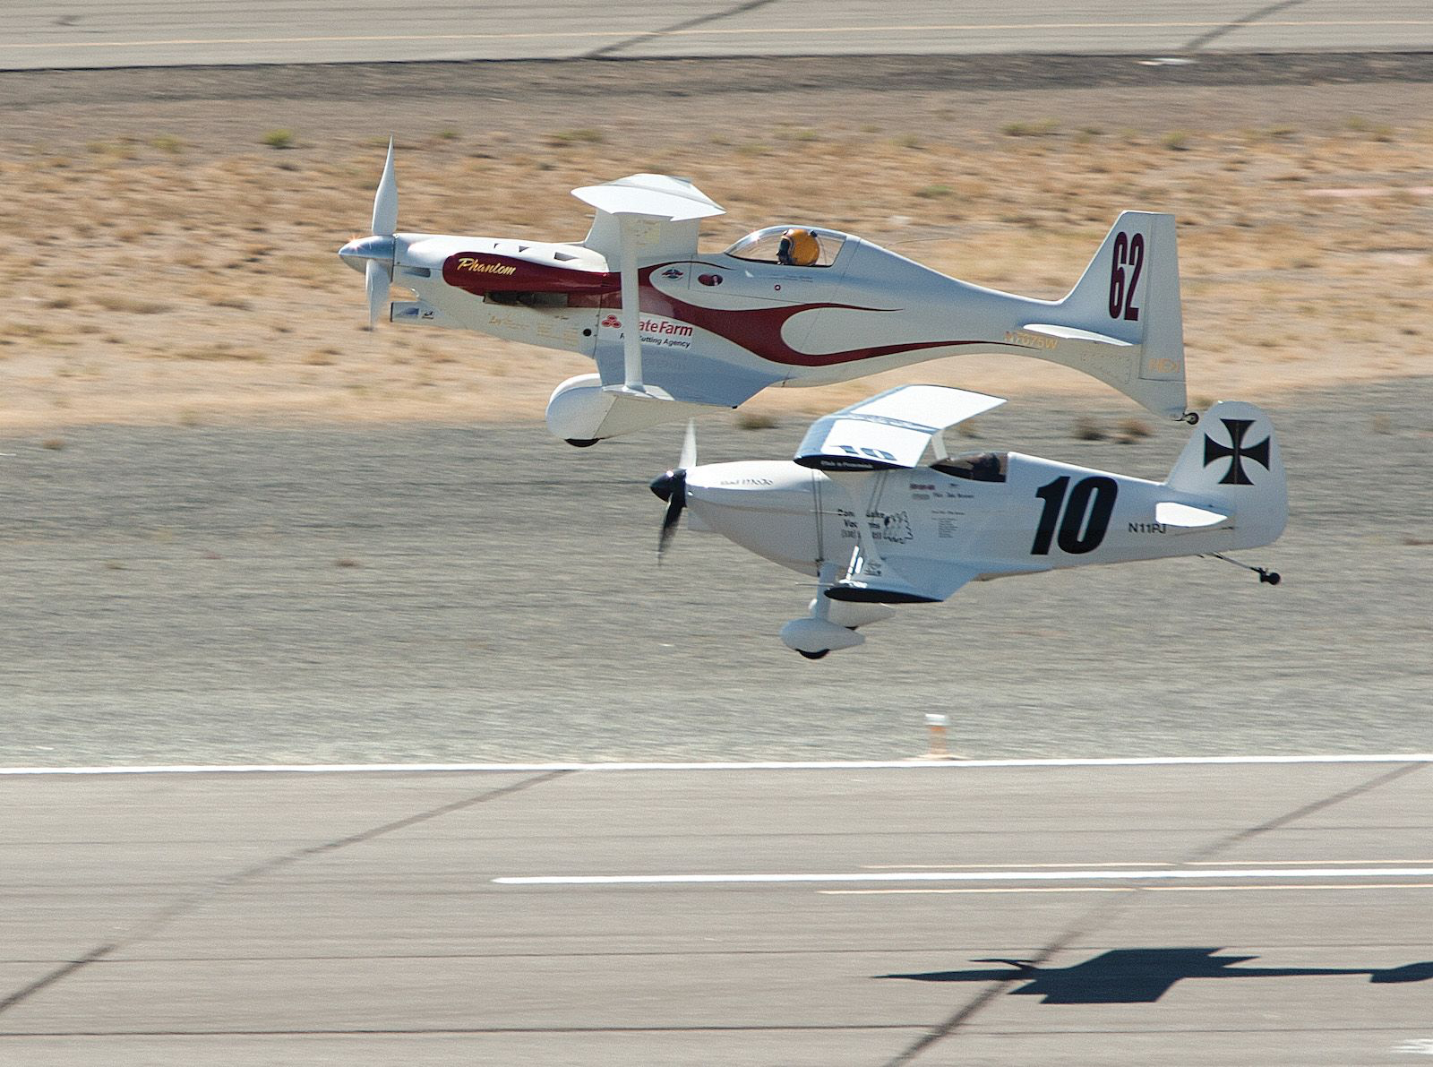
Agenda
Introductions
BARC Code of Conduct
PRS Training Objectives
Requirements
Racing License
Tech Inspections
Intro to Pylon Racing
Flight Evaluation Profile
Racing Procedures
Threats & Emergencies

Slide 3
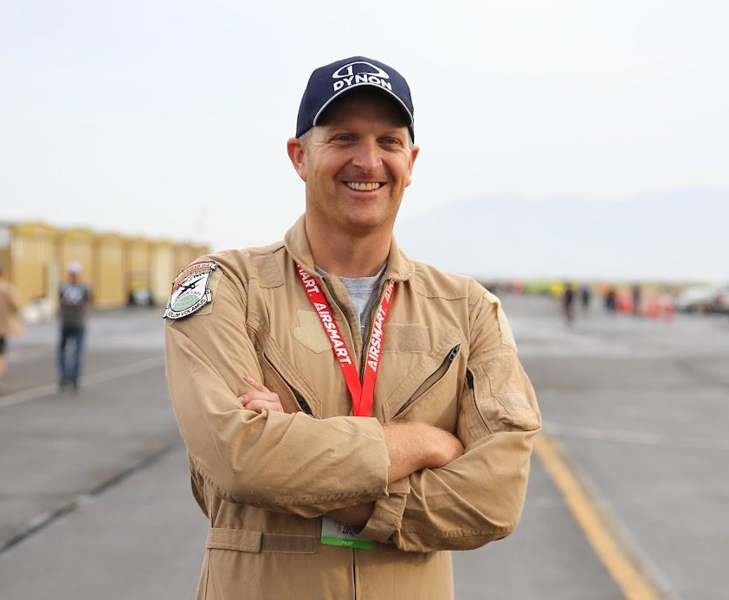
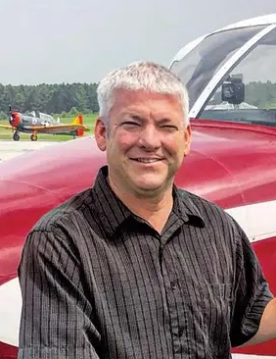
Introductions
2025 PRS Instructors
Scott Thomson
Class President, CFI
Occupation: Pilot
Co-Owner, Pilot of “Second Hand”
Kevin Harper
Vice President, DPE, A&P
Occupation: Pilot
Owner, Pilot of “Yellow Bomber”

Slide 4
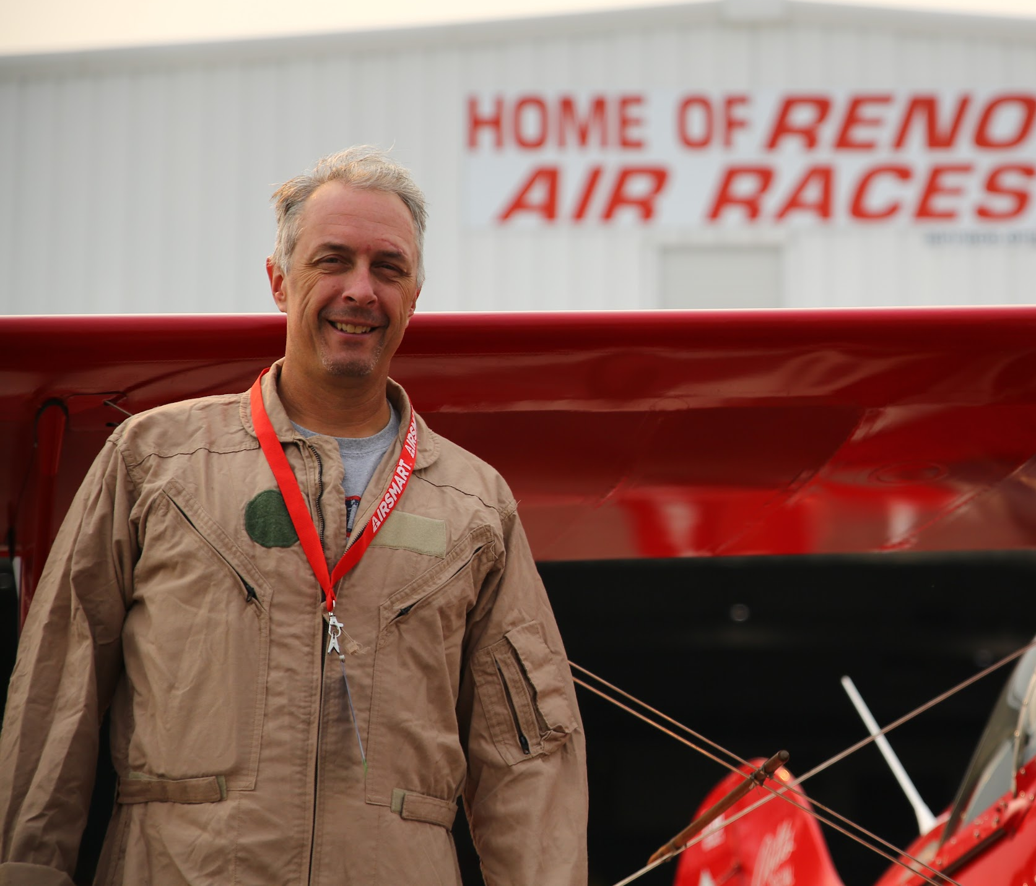
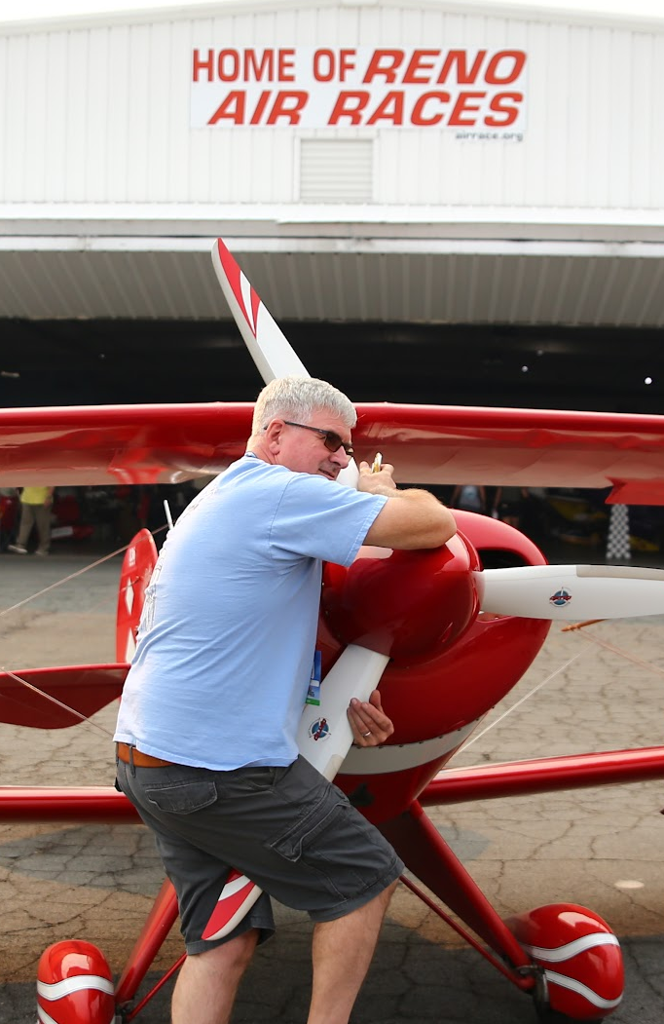
Introductions
2025 PRS Instructors
Andrew McVicker
Treasurer, CFI
Occupation: Pilot
Pilot of “Red Squirrel”, Owner of “Yellow Jersey”
Jeff Rose
Secretary, Comm/Multi
Occupation: Biplane test pilot, side-hustle dentist
2016 Reno Biplane Gold Champion

Slide 5
BARC Code of Conduct
By signing the BARC Good Conduct Agreement you’ve committed to upholding the following priorities:
Safety
Good Sportsmanship
Rules Compliance
Dispute Resolution
Professional Behavior
Class Delegate

Slide 6
PRS Training Objectives
Fundamentals of Low Altitude Flying
The Proper Course
Non-cooperative Formation
Pylon Air Racing Immersion
Race Course Familiarization
Lessons Learned
Safety & the Racing Mindset

Slide 7
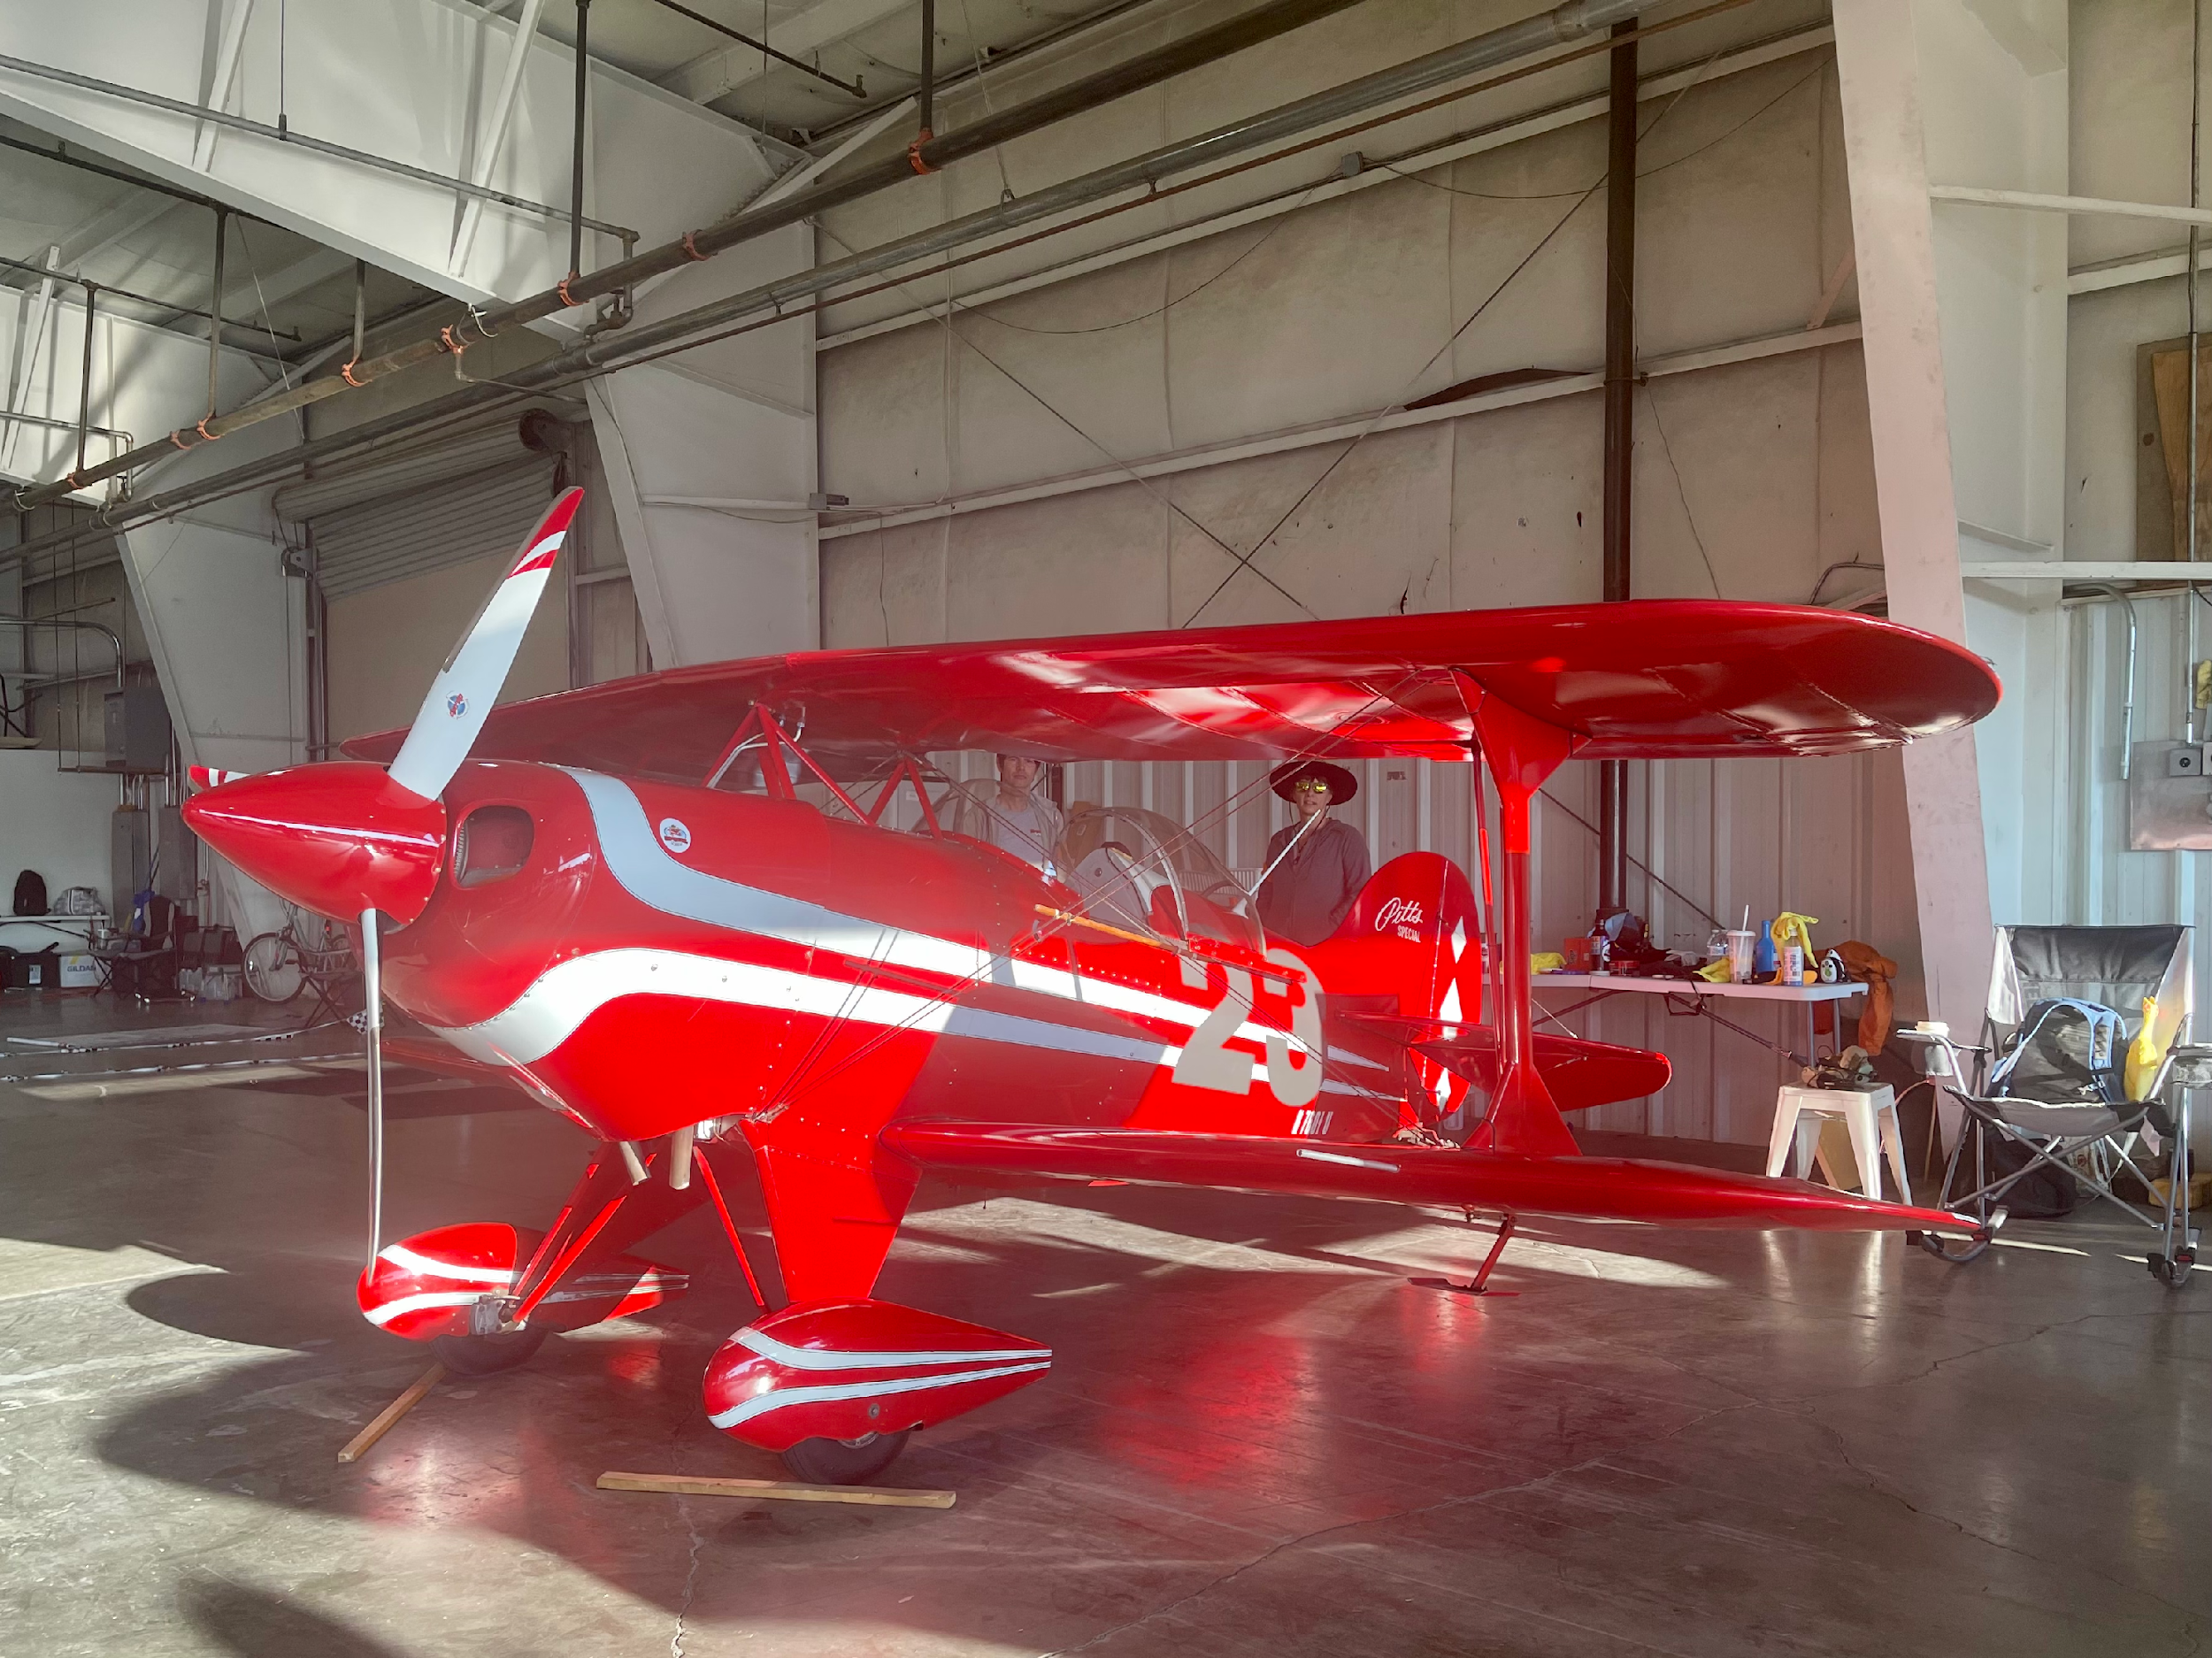
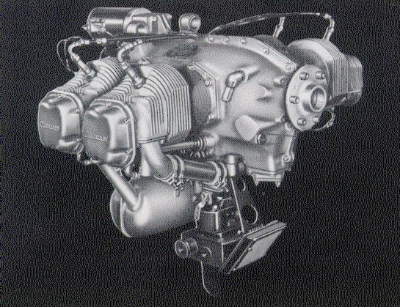
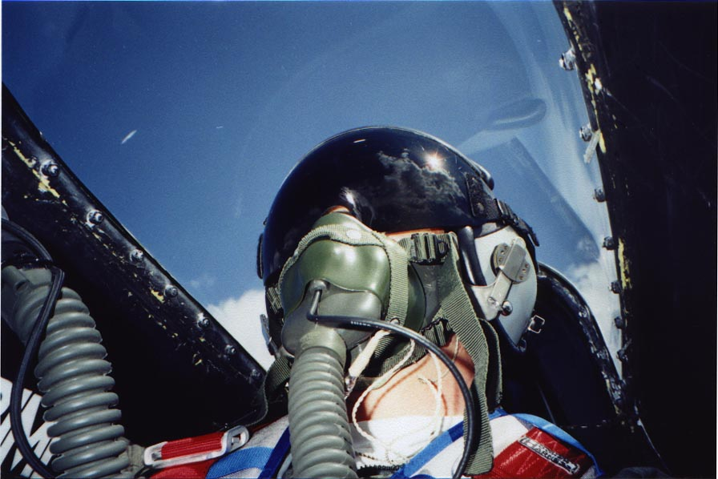
Requirements
Aircraft
Engine
Pilot

Slide 8
Aircraft Requirements
Fixed MLG & tailwheel
Fixed Pitch prop….C/S ok for 2 seat
Upper and lower wings - approx 50% each
Lower wing - no less than 45%
Upper wing cabane or pylon mounted
Wings 75 sq ft combined horizontal area minimum
Functional two-way VHF radio

Slide 9
Engine Requirements
Single Seat - max 364 ci
Two Seat - max 560 ci
Air-cooled
Direct Drive
Aircraft Piston Engine
Modified Cams allowed
Compression ratio unlimited
Porting & Polishing allowed
Any ignition, must not interfere with radio communications

Slide 10
Pilot Requirements
Private Pilot license, Commercial or better preferred
2nd Class Medical (minimum), current within 6 months – race only.
500 hrs PIC on fixed wing aircraft (May be reduced for time in type)
25 hours in type
5 hours in last 6 months
5 T/O & landings in last 90 days
Rookie applications are screened for this

Slide 11
Race License
Eligibility:
  BARC Membership
  Meet minimum experience requirements
Awarded upon successful completion of PRS
Valid for 24 months plus extension to end of calendar year

Slide 12
Race License Duration/Renewals
Good for 24 Months Plus Extension to End of Calendar Year
  Ex: License Issued 21 May 25 Good Until 31 Dec 28
Revocable Anytime Ops or Pilot Committee Observe Unsafe Flying
  Repeat Exam at a minimum before Further Racing
  Letter of Reprimand
  Probation Period
  Lifetime Suspension Possible
We Police Ourselves Strictly. The FAA is watching!

Slide 13
Race License Practice & Preparation
Fly Your Race Plane Often
Practice Just Like You Were Racing
  Full Race Clothing/Safety Gear
  Allowable Tolerance for Takeoff Roll
Practice Simulated Engine Out Landings
  Add Power if Needed
Be proficient in the entire performance envelope of your aircraft
Know Your and Your Aircraft’s Limits by Heart

Slide 14
Tech Inspections
BARC Tech Rules
BARC Operations Manual
BARC Tech Inspection Procedures
Read and Understand These Documents!
*https://www.biplaneairracing.com//

Slide 15
Tech Inspections
Biplane Tech Inspection Procedures
  “This document is not controlled and may be modified at any time by the Technical Advisor.”
  “The items to be checked at any particular race meet will be determined by the Tech Director or his Deputy”

Slide 16
Pre-Race Tech Inspections
Documents
Airframe
Engine
Fuel
Avionics (Including 2 way radio function check)

Slide 17
Required Documents
Airworthiness
Registration
Operating Limitations
Weight & Balance
Insurance
License
Medical
Aircraft Log Books
Evidence of Pilot Currency
Race License (N/A for 2025)
Identification
RARA Registration verifies these items..we might too

Slide 18
Airframe Check Items
Weight (500 lb min)
CG (8- 25% MAC)
Wing Area (66 Sq ft)
Landing Gear
Brakes
Visibility
Cockpit (Freedom, Turnover Protection)
Canopy (Security/Release)
Construction (Quality, Materials)
Propeller (Condition)

Slide 19
Airframe Check Items
Eng mount (no cracks)
Fuel System/Vent
Flight Controls (connected/correct)
Ballast?
Harness Condition
Control Sys “Slop” (Ails, Rud, Elev)
Proper Safety (prop, controls, etc.)
Firewall Security (seals)
Race Number (Legible, 16 inches x 2 inches stroke)
Engine Retention Cable

Slide 20
Engine Check Items
Safety Cable (¼”)
Mags/Elec Ignition
Exhaust System
Engine Controls (Throttle/Mixture)
Fuel System (Cutoff/Pumps)
Prop Safety (prop, controls, etc.)
Use/Application of Safety Wire

Slide 21
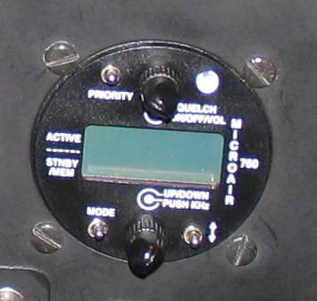
Avionics
Radio must Operate on the race course at speed
Work Antenna & Shielding Before the Race
Be Alert for Stuck Mic Switches
Don’t Create A Hazard with Your Radio Installation
  Batteries
  Freedom of Movement
  Projectile During Crash

Slide 22
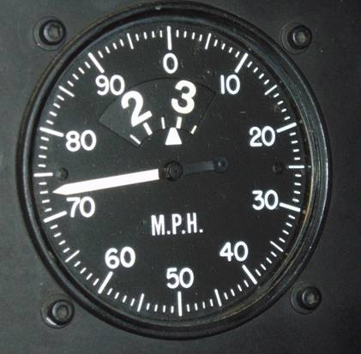
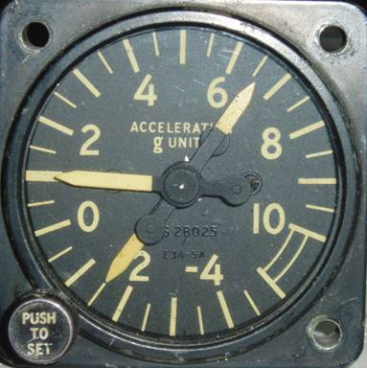
Flight – New or Modified Aircraft
1.1 V_{h} Dive Demonstration
4g pull-up Demo
  Owner to Provide Recording G-Meter
  Meter must be Mounted Securely

Slide 23
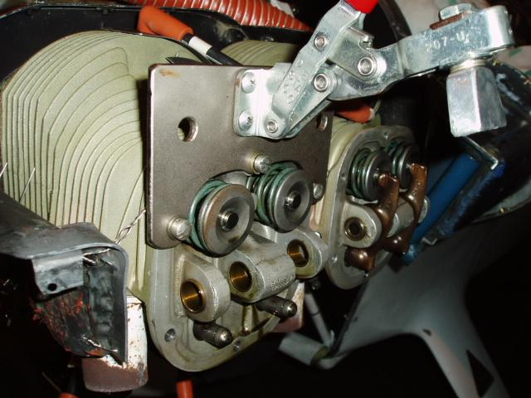
Post-Race Tech Inspections
Winners
  Top 3 Finishers Gold Guaranteed
  Top Finisher and Possibly 2 & 3 from Silver & Bronze

Slide 24
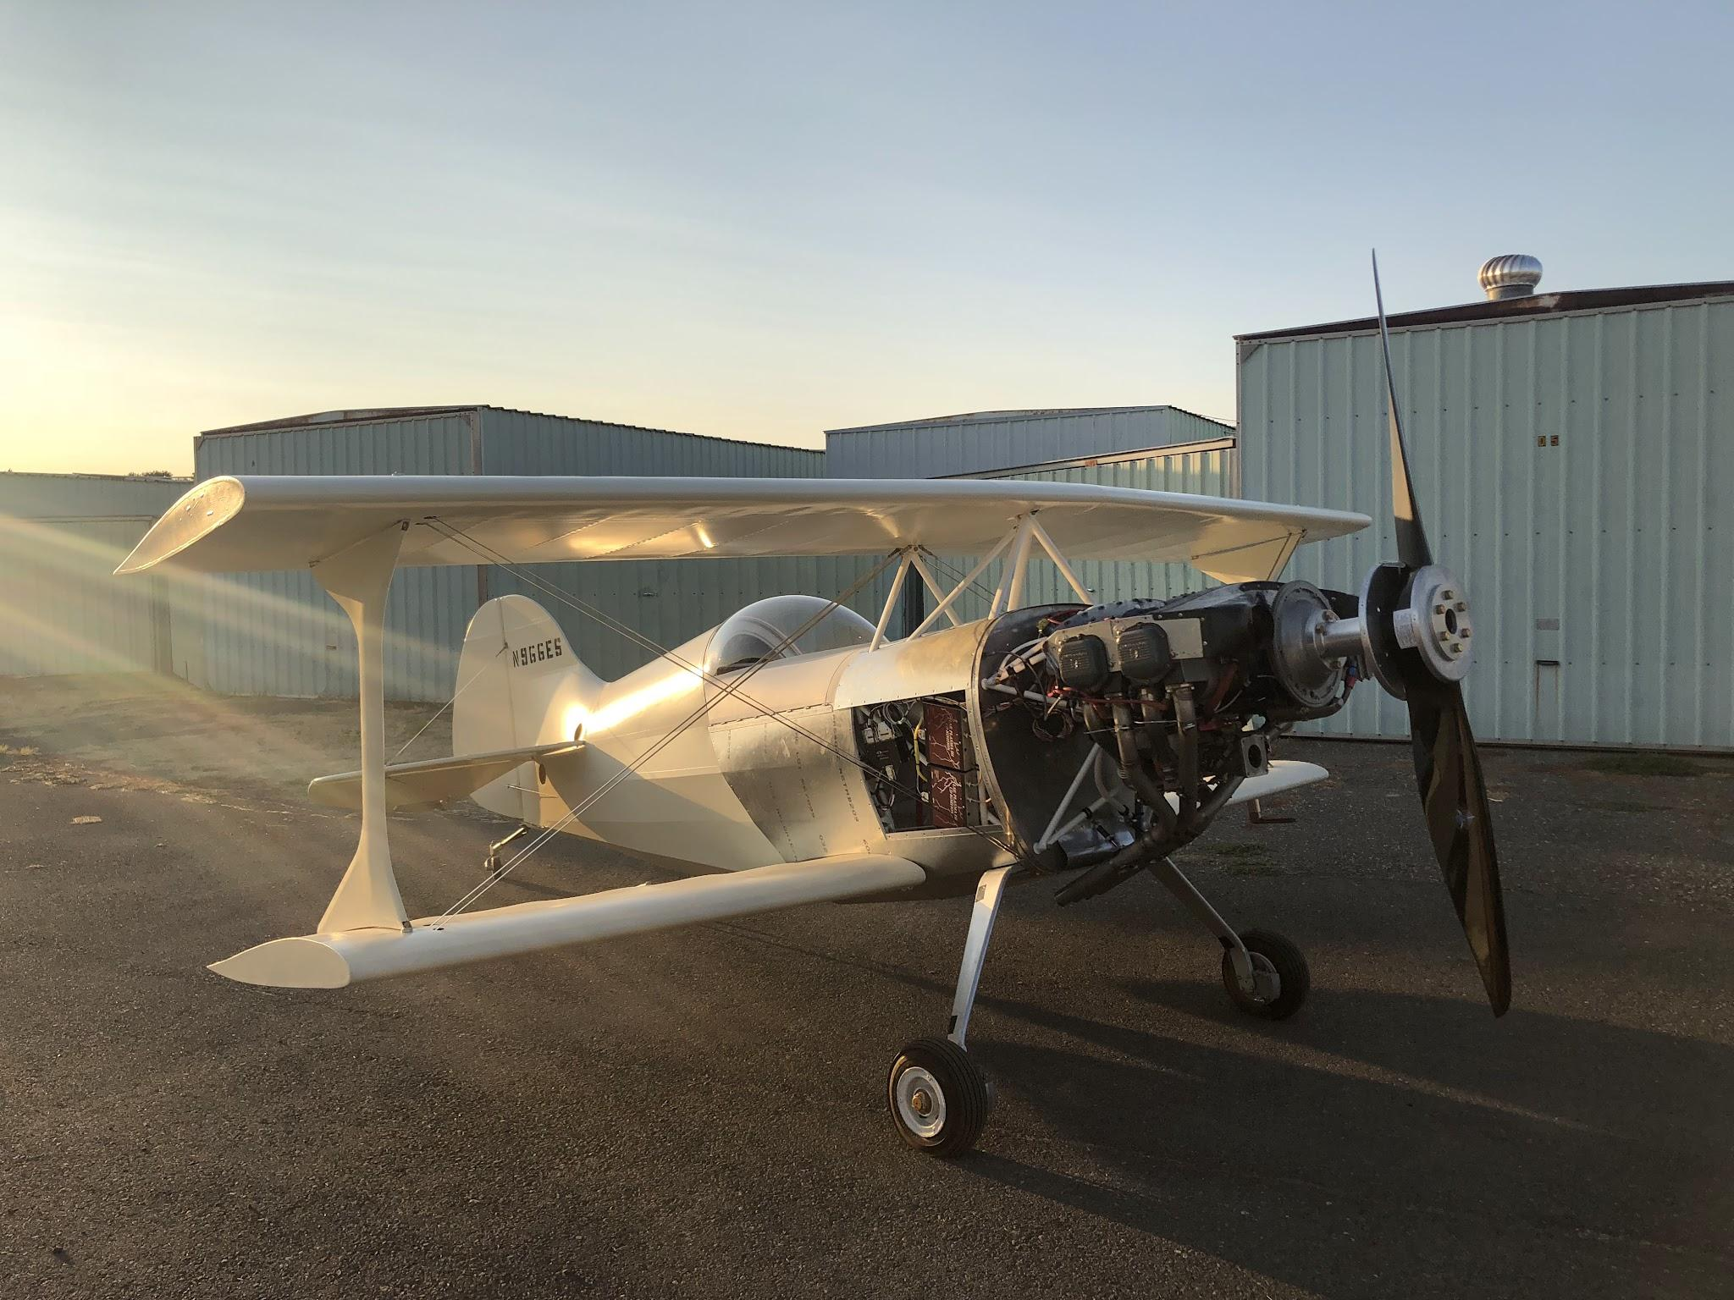
Tech Inspection Summary
Verify Compliance with Tech Rules
  Details available on-line
Spot Unsafe Conditions
Goes Better if You Have Checked Everything Before Arriving at a Race Site

Slide 25
Intro To Pylon Air Racing

Slide 26
Fundamentals of Low Altitude Flight

Slide 27
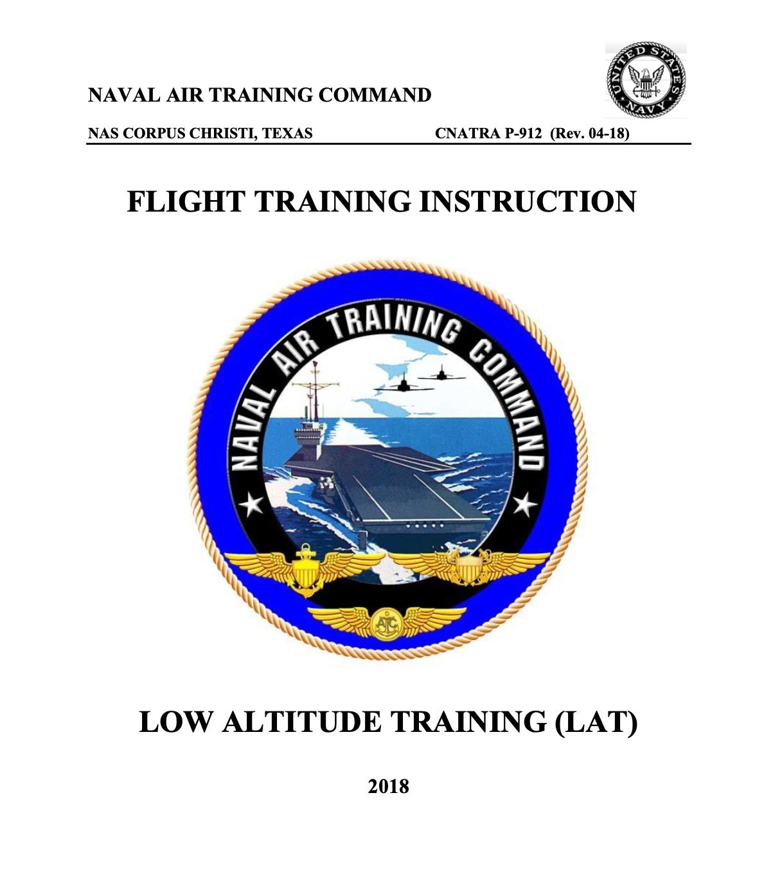
Ref from USAF 11-202v3
Time to Impact is less than one second in an overbank from 50’
Overbank and Time-to-Impact from 50'
Bank Angle | Gs for Level Turn | Overbank/Expected G | Time to Impact
60 | 2 G | 70 deg/ 2 G | 0.99 seconds
70 | 3 G | 80 deg/ 3 G | 0.81 seconds
75 | 4 G | 85 deg/ 4 G | 0.69 seconds
80 | 6 G | 90 deg/ 6 G | 0.56 seconds

Slide 28
The Racing Line - Proper Course
“The course an aircraft would optimally fly in the absence of any aircraft that follow”

Slide 29
Wake turbulence awareness

Slide 30
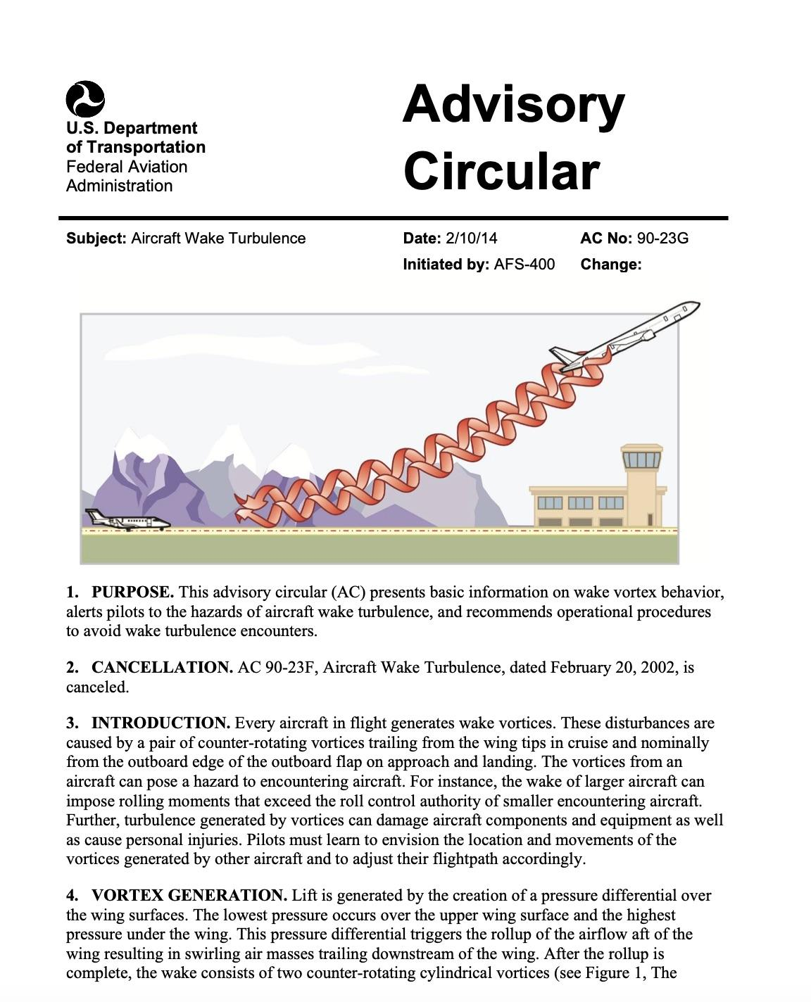

Slide 31
“Pylon racing isn’t formation flying…but, it’s formation flying”

Slide 32
Formation Flying Mechanics
Biplane air racing is non-cooperative formation
Contract change occurs when a pass has been executed
“Racing room” completes a pass (4 lengths)

Slide 33
Formation Flying Mentality
You are part of an 8-Ship “Formation”
  Not a Rogue/Solo Pilot
You are both Lead and Wingman
Discipline in Your Flying is Required
There’s A Contract Between Wing and Lead
  Always Honor the Contract!

Slide 34
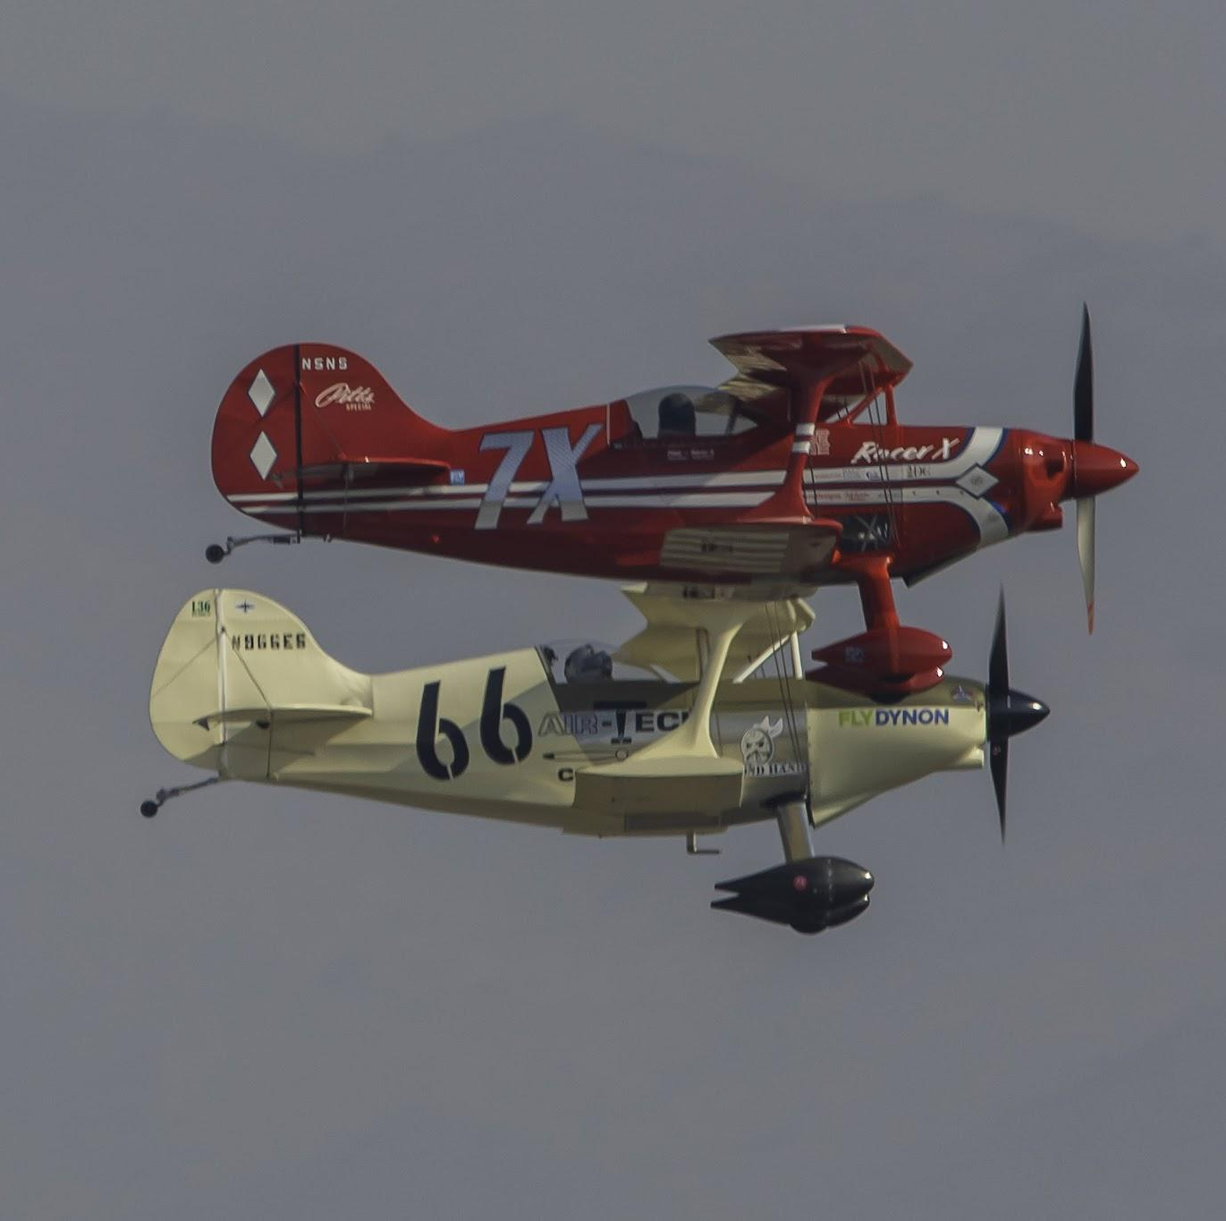
Formation Flying Mentality

Slide 35
Formation Flying References
Formation and Safety Team (FAST) National Formation Guideline version 1.2
Navy T-34C Primary Formation Training Manual (CNATRA P-357 (Rev. 09-06))
USAF Manual (AFMAN) 11-248, T-6 Primary Flying, 10 Oct 2008
Canadian Bushhawks Liaison Squadron Formation Flight Syllabus, 1994.
T-34 Association Formation Flight Manual, 1989.
Team RV Formation Training Guide and RV Supplement to the T-34 manual. (2002).
“Flying in Formation, The Standard for Group Flight”, by Frank W. Hampson, 1988
Formation Flight Manual, by Jeff Crutchfield, 1995
Pitts Special Formation Flight, 11 Sep 2010

Slide 36
Flying Training and Evaluation Profile

Slide 37
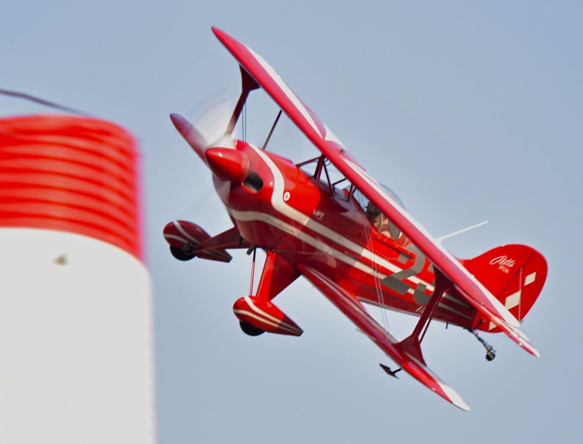
Training Maneuvers
Two Course Laps as Wingman
  Maintain position within 3 ship lengths/widths
  Smooth inputs, no erratic flying

Slide 38
Training Maneuvers
Two Course Laps as Lead
  Maintain predictable, stable platform
  Smooth inputs, no erratic flying

Slide 39
Training Maneuvers
Safe pass (4 lengths minimum)
  Minimal diving, smooth is fast
  Radio calls “7X Passing 23”

Slide 40
Maneuvers/ Evaluation
Race Takeoff
Full Power, Unassisted Launch from Standstill
    Track Straight +/- 10 feet
    Positive Control During Transition to course or climb

Slide 41
Maneuvers
Three Course Laps Solo
  “Proper Course”
  Predictable, stable platform
  50-250 AGL is course Limit
    No significant Change in Altitude

Slide 42
Maneuvers
Formation Flying & Passing Techniques on Race Course
  Line selection
  Wake turbulence awareness
  Safe execution

Slide 43
Maneuvers
Left Hand Roll
  1,500 Ft. AGL or Greater
    Less Than 50 ft. Altitude Loss
Right Hand Roll
  1,500 Ft. AGL or Greater
    Less Than 50 Ft. Altitude Loss

Slide 44
Maneuvers
Re-Enter Course between 3-4
Normal race finish to normal landing
  Pull Off Course at Home Pylon (Race Finish)
    Radio Calls (“RACE 23 OFF THE COURSE”)
    Positive Control at All Times

Slide 45








Non-US Pilots
Must Demonstrate All Race License Maneuvers to Pilot Committee Chair or Designee before Racing Even if Current in Home Country
Must Be Able to Communicate with Biplane Starters, tower and RARA in English
  Complete Comprehension of Rules & Instructions Essential
FAA Recognizes Medicals & Licenses from Other Countries
FAA Can Issue a US Pilot License (based on equivalent Foreign Documents) with Relatively Little Hassle
FAA Accepts Airworthiness Certificates from Foreign Countries – No Additional FAA Inspection Required for Aircraft

Slide 46
Race License Flight Card
Complete All Preflight and Pre-Takeoff Checks
Race Takeoff
  Set Takeoff Power/Hold with Brakes
  +/- 10 ft lateral variation entire roll
GREATER THAN 1500’
L/H Roll
  No more than 50 ft. loss in altitude
R/H Roll
  No more than 50 ft. loss in altitude
Enter race course on back course
3 Laps or more at race speed
  Constant altitude in turns
Normal landing
  Runway Centerline
  Landing Zone -> OFF by Taxiway H

Slide 47
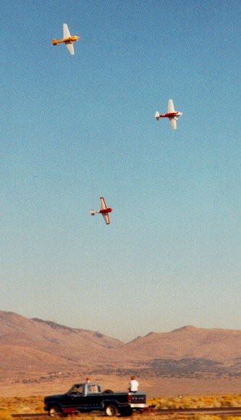
Racing Procedures
Flags
Runway/Launch
On The Course
Recovery
Post-Race
Speed, Points, & Pairings
Video Replays

Slide 48

Flags
Before Race = Less than 5 Minutes to Launch
During Race = All Aircraft Pull Off Course and Land
Before Race = Less than 10 Seconds to Launch
During Race = Race Has Started (First Lap)
During Race = Last Lap Has Started
Checkered Flag During Race = Race Over
Expect Ops Radio Call in Addition to Flag

Slide 49
Flags
All Aircraft Fly With Caution
You’re Busted!
Vacate the Course Immediately
Avoid a Membership in the Black Flag Club

Slide 50
Runway/Launch
Positioning
Takeoff

Slide 51
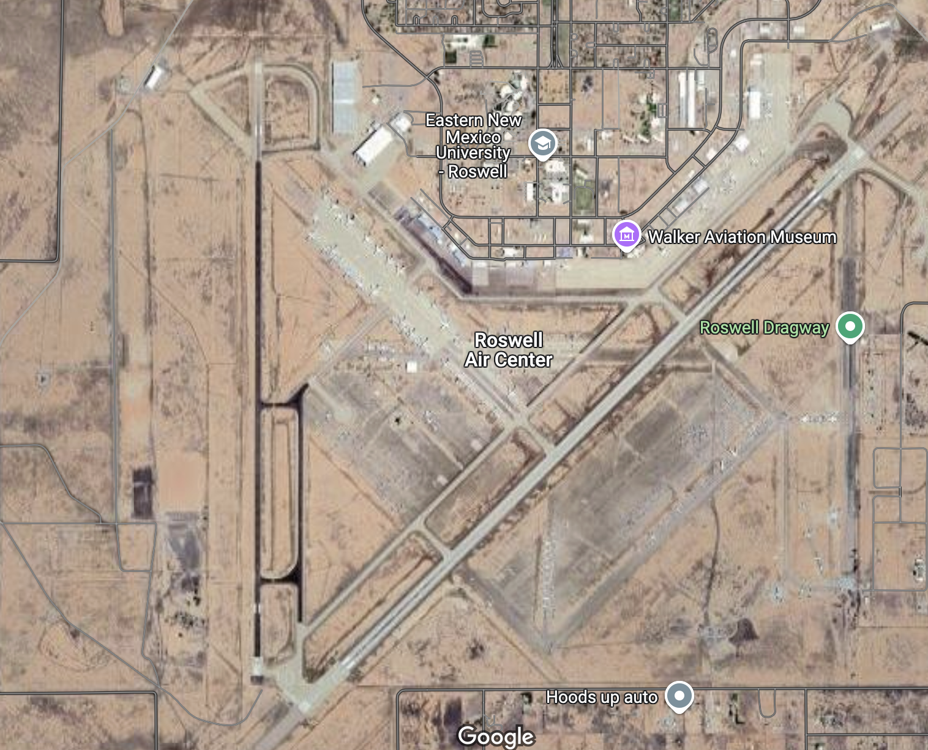
ONE type of Start:
Racehorse, Row Start
Sequential
4 second handicap per row
WE ARE THE FLAGGERS

Slide 52
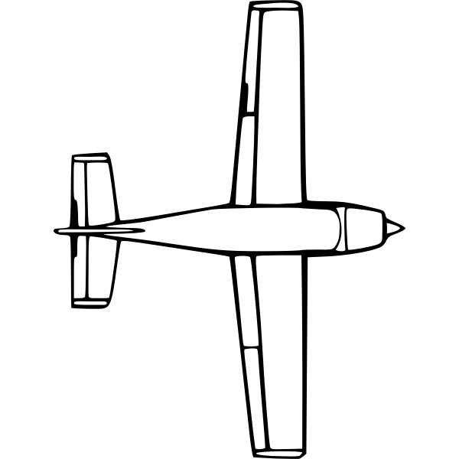
Racehorse Start
2 - 2 - 2 - 2 Spacing For 8 Plane Races
Aircraft are spaced 400 feet apart
Position Choice Given in Order of Speed
  Consider Wind Direction
  Know/Consider the Competition’s Performance
  Use Your Checklist
35

Slide 53
Simultaneous Start
Runway/Launch Countdown
Red flags will come up at T-5 minutes. Hand signals and radio calls will be made for subsequent minutes.
ACKNOWLEDGE WITH RACE #
Red Flag will be joined by green flags at T-10 seconds. Drop of the green flag signal the start of the race for your row
The race begins for you when the green flag drops for your row. Your starting time will be adjusted by 4 seconds
Timing begins from the time the first aircraft crosses the home pylon after the start lap

Slide 54
Start
2 - 2 - 2 - 2 Spacing For 8 Plane Races
Position determined by speed
  Consider Wind Direction
  Know/Consider the Competition’s Performance
  Use Your Checklist
Normal interval time will be 4 seconds, but may be between 3-10 seconds, predetermined by Ops Director/Starter
35

Slide 55
Show Day Start
Runway/Launch Countdown
The red flag will come up at T-5 minutes. It will be replaced by the green flag at T-10 seconds.
Each row will be started with subsequent green flag drops for their row.
  The first drop of the green flag signals the start of row 1 launch.
  The green flag will be raised again and dropped to signal row 2 launch.
  The green flag will be raised again and dropped to signal row 3 launch.
  The green flag will be raised again and dropped to signal row 4 launch.

Slide 56
Runway/Launch “Delay”
If the start is delayed for any reason, a command will be broadcast on the race frequency “DELAY DELAY DELAY”
  The delay time will be determined and broadcast on the race frequency asap.
  The delay can only occur between T-5 mins and T- 10 seconds.
  Raising of the green flag will cancel any “delays.”
  Any pilot, the ops director, or race control may initiate a delay.

Slide 57
Race “Abort”
If the start is aborted for any reason, a command will be broadcast on the race frequency “ABORT ABORT ABORT”
  The command to ABORT immediately cancels the race.
  The abort can only occur after T-10 seconds.
  After hearing the command to “Abort”, the race pilot will immediately shut down their engine, and put their stick hand thumb in the top of the canopy.
  Once all props are stopped, green flag will slowly be lowered, the green flag will remain raised until all props are stopped.
  Any pilot, the ops director, or race control may initiate an abort.

Slide 58
Race “Abort” After Start
Airborne aircraft will hold in the queue until the runway is available to land. If runway is fouled, runway 3/21 will be primary

Slide 59
Mayday
Got a problem? Call it. RARA brief contains details
FLY THE AIRPLANE
“Race XX, MAYDAY”
“Landing Intentions”
“Nature of Emergency”

Slide 60
Runway/Launch - Takeoff
Critical part of the race –
Non-Cooperative Formation
  Lack of Visibility over the Nose – Engine Failures Ahead
  Runway Drift/Departure Due to Crosswind
  Prop Wash and Wake Turbulence
  Beginning Turns Near Stall Speed (AOA)
  Look Around and Above Continuously!

Slide 61
On The Course
Course Overview
Consistency
Altitude Control
Passing
Bill Rogers Photo

Slide 62
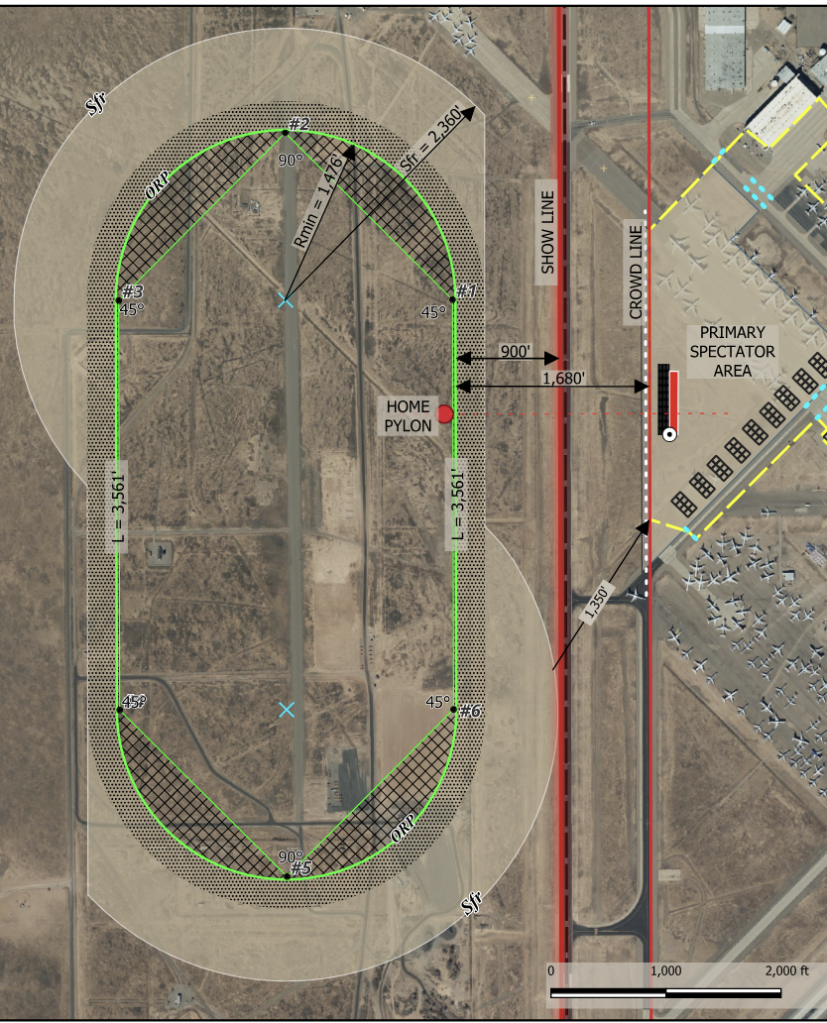
On The Course – example
Symmetrical Course
Pylons Well Marked
Always Fly Counter-clockwise
Stay West of showline

Slide 63
On The Course - Consistency
Fly a Smooth, Predictable Line
  No Jinking!
  Erratic Operation is UNSAFE FLYING
  Disqualification/License Revoke for Repeat Offenses
Look and Think Two/Three Pylons Ahead- Spot turn, set bank, pull to known G
Never Turn Right to Avoid a Pylon Cut! (RIP)
  Take the Time Penalty (2-4 secs x # laps) and be Safe
  Right turn will result in Disqualification/License Revocation/Death
Line Changes On Straights Are Possible
  Be Positive the Space (Line) You Are Moving To Is Clear!
  Use Shadows to Help Determine Traffic

Slide 64
On The Course - Altitude
Do Not Climb in Turns
  Increases Mid Air Collision Potential
  Decreases Your Speed
Do Not Fly Higher than 250 feet AGL
  Max 250 ft. AGL at Home Pylon (Out of Timing Camera Field of View)
Low Line is Fastest if Traffic and Turbulence Permit
  Target Wing Tip not lower than Pylon Height (Safety Margin and Avoids Questionable Low Flying Call)
High Line May be Needed for Traffic/Turbulence
  Harder to Fly Tight Course Because You Can’t See the Pylons As Well

Slide 65
On The Course - Altitude
Example - Do Not Climb/Dive with terrain changes
  Inefficient (Lowers Your Speed)
  Results From Flying From Can to Can
    Cans (Pylons) are Constant Height AGL, not MSL
  More Likely to be Low at Home Pylon and Get Called for Low Flying
Constant MSL Flight Path
Constant AGL Flight Path
Low Flying Risk
1
6
Home Pylon

Slide 66
On The Course - Passing
Maintain Positive Visual Contact During Entire Pass!
Be Absolutely Sure the Space You Are Moving to Is Clear
Four lengths, this is measurable with cameras
“Race 3, Passing 8” - Reply not required
Always Pass on the Outside Unless the other Aircraft is Extremely Wide and not flying proper course - Expect a protest for an inside pass
Stack High in Turns - Convert Altitude to Speed in Straight
Do Not Pass on the inside
Slower Aircraft Has Right of Way but Must Maintain Proper Course

Slide 67
Recovery
Checkered Flag = Race Over for Everyone
  Do Not Fly Extra Laps
Cross Home Pylon (Checkered Flag/Radio Call)
  Look Left and Up
  Gently Begin Climbing Left Turn In Trail (No Rolls!)
  Retard Power
Cool Down While Scanning for Other Aircraft
Always Be Able to Make the Runway If Your Engine Quits

Slide 68
Recovery
Collect Yourself Mentally, and BE ON THE LOOKOUT
  Transition from Race Mode to Landing Mode
Listen for Active Runway Call on Radio
Report Base & Traffic on Radio
  “Race XX Base for 35, 95 in Sight”
Listen for Maydays/Hazard Alerts
Be Alert for Landing or Departing Traffic From Opposing Direction (Racers, Helos, etc.)
Always Be Able to Make the Runway If Your Engine Quits

Slide 69
Recovery
Maintain SA Via Eyeballs and Radio
Pick Go-Around Point and Use It
  Go Around if You Get Into PIO
NOT OVER UNTIL ALL SAFE ON DECK

Slide 70
Cool Down – Recovery 35
Descend on Downwind to 4,700 ft MSL for Pattern. (1k AGL)
L/H Turns @ 5,500 ft MSL for Cooldown. Follow racecourse
Cooldown: 1800’ AGL
Pattern: 1k’ AGL
4
3
5
2
Race Course Show Line
6
Home
1
35
Extreme Danger

Slide 71
Cool Down – Recovery 17
L/H Turns @ 5,500 ft MSL for Cooldown. Follow racecourse
Descend on Downwind to 4,700 ft MSL for Pattern.
Cooldown: 1800’ AGL
Pattern: 1k’ AGL
4
3
5
2
Race Course Show Line
6
Home
1
17
Extreme Danger

Slide 72
Missed Approach– Runway 17
Re-Enter at 6,500 ft. MSL
Descend on Downwind to 6,000 ft MSL for Pattern.
Climb to 5,800 ft. MSL
Cooldown: 1800’ AGL
Pattern: 1k’ AGL
4
3
5
2
Race Course Show Line
6
Home
1
17
Extreme Danger

Slide 73
Dual Runway Recovery - 35/03
2
NO FLY ZONE
Cooldown: 1800’ AGL
Pattern: 1k’ AGL
35
3

Slide 74
Recovery
Know the pattern, who’s where
FLY PRESCRIBED GROUND TRACK
Clear ahead and Below
Single aircraft/runway ops- no hot side/cold side yet (2026 if feasible)
Hot
35
Cold
  Hot Side is Always Furthest From Crowd
Always Be Able to Make the Runway If Your Engine Quits

Slide 75
Recovery
Plan your landing to Taxi Off the Runway by H
Do Not Block Taxiways if At All Possible
Ensure Switches are OFF
Wait for Tow Vehicle or Taxi Back if You Can
Calm Down, Decompress, Breathe
Always Be Aware of Your Emergency Plan

Slide 76
Post Race
Post race pilot decompression with pilot committee chair or delegate - Mandatory
Refuel
Debrief with Your Crew
  Lap Times
  Unsafe Flying/Lessons Learned
  Airplane/Engine Performance Issues
Victory Ride Down the Flight Line
  Your Adoring Fans (Remember Your Crew)
Group Debrief in Hangar or Office Area
  Honest Feedback From All Involved
  Try Not to Come to Blows Before the Debrief!

Slide 77
Post Race
Conduct Thorough and Detailed Inspection
  Propeller (Delams, Cracks, Nicks)
  Engine/Compartment (Anything that Can Become Loose)
  Use Great Caution when Moving Propeller on Hot Engine
  Flight Controls/Linkages

Slide 78
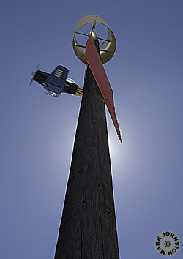
Speed, Points, and Pairings
Speed Computation
  Qualification
  Racing
Points and Pairings
  Qualifying
  Heats
  Finals (Bronze/Silver/Gold)
  Important Notes

Slide 79
Qual Speed Is Best of 2 Laps
Time Starts And Ends When You Cross Home Pylon
Warm Up
Get In “The Groove”
Radio Call between 3/4
Green Flag - Verify
White Flag - Verify
Checkered Flag – Exit
Speed = 3.1875 miles / Time for Lap (best of 2)
4
3
5
2
6
Home
1
Extreme Danger

Slide 80
Race Speed Is Average of Laps Completed
You Could be Here When Race Timing Begins
Time Is From When First Aircraft Crosses Home Pylon On Lap 1 Until You Cross Home Pylon On Last Lap
Speed = # Laps X 3.1875 Miles / Time
Distance (3.1875) is Arc Length Around Pylons
First Lap Is “Pace” Lap But Racing Begins At Brake Release – Go As Fast As You Can And Pass When/IF Safely Able
Pace Lap Is Not Included In Race Speed
4 Second handicap per row
8
7
4
3
6
5
2
5
6
Home
1
4
3
2
1
Extreme Danger
x
Race Aircraft

Slide 81
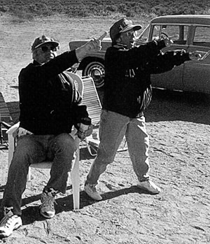
Race Speed Adjusted for Pylon Cuts
2 Seconds per Race Lap added to Time
Example:
Baseline Race Time = 5 min 55 secs
Race Distance = 19.125 miles (6 laps)
Baseline Speed = 193.944
1 pylon cut = 12 second time penalty
Adjusted Race Time = 6 min 7 secs
Adjusted Race Speed = 187.602
Revised Finish Position per race time
Cut!
43!

Slide 82
Hazards - Emergencies
What Has Gone Wrong in the Past
How to Eliminate or Mitigate the Risk
Consider All the Possibilities and Be Prepared

Slide 83
Hazard/Risk
In flight structural failure (Wings, Tails, Control Surfaces, Engine Mounts, Control System Linkage)
Consequence:
Pilot Killed or Severely Injured; Aircraft damaged.
Ever Actually Happen?
Yes.
Risk Mitigation
Inspect Structure Thoroughly & Frequently
Eliminate/Minimize Hinge Free Play
Avoid Turbulence (Wakes, Dust Devils)
Evaluate Load Paths

Slide 84
Hazard/Risk
Engine Malfunction (Untested Mods, Plug Gaps, Timing, Cam Profile, Rings, Lifters, Fuel/Oil Starvation, Pistons Burn Through, Connecting Rods Fail, Loss of Oil Pressure, Mags Come Loose, Props Delaminate, Props Crack, Oil Caps Come Off, Spark plugs Come Loose, Mags/Components Fail, Mixture Cable Slips/Breaks)
Consequence:
Flight (Qual or Race) Abort
Aircraft Damaged in Off-Airport Landing
Ever Actually Happen?
Yes. A lot.
Risk Mitigation
Test Modifications (at Power and Speed) Before Arriving
Be Wary Of Advice From Other Racers
Have a Plan for a Failure at Any Point on the Race Course
Perform Thorough Pre-flight Inspection, Especially After Each Hard Run
Practice Emergency Procedures Often – Land Before Complete Loss of Power

Slide 85
Hazard/Risk
TFOA (Things Falling Off Aircraft) [Wheel Pants, Exhaust Stacks, Cowling, Spinners, Fairings, Speed Tape Peels, Oil From Other Aircraft]
Consequence:
Vibration, Flight abort; FOD to Fellow Racers’ Planes; Debris on Runway (landing hazard)
Ever Actually Happen?
Yes.
Risk Mitigation
Careful Maintenance and Preflight Inspection
Monitor Radio for Ops Alerts
Discontinue Flight if Unusual Vibration Occurs…Do Not Continue Until TFOA Occurs

Slide 86
Hazard/Risk
Animal Encounters (Insects, Tarantulas, Birds, Coyotes, etc.)
Consequence:
Pilot Distracted, Aircraft Damage if Birds/Coyotes Struck
Pilot Injury If Bird Penetrates Canopy
Ever Actually Happen?
Yes.
Risk Mitigation
Careful Preflight to Remove Unwanted Pax
Pre-Think Response
Monitor Radio for Ops Alerts
Use Helmet with Visor

Slide 87
Hazard/Risk
Brakes Fail (Won’t Hold/Won’t Release)
Consequence:
Loss of Directional Control; Aircraft Damaged.
Possible Collision with Other Aircraft/Objects/People
Ever Actually Happen?
Yes.
Risk Mitigation
Inspect and Test Brake System Before Reno
Perform Full Power Run Ups to Verify Brakes Hold
Bleed Brakes to Remove All Air
Insure Hydraulic Fluid is Serviced

Slide 88
Hazard/Risk
Canopy Issues (Comes Open In-flight, Totally Separates (TFOA), Shatters Due to Contact with Helmet)
Consequence:
Flight Abort.
Vision Impacted due to 200+ MPH wind blast; Landing Challenge
Ever Actually Happen?
Yes. Too Often!
Risk Mitigation
Use Checklist to Ensure Canopy Closed and Latched
Use Redundant Canopy Latches
Use Helmet with Visor

Slide 89
Hazard/Risk
Runway Collision (Improper Hot/Cold Side Procedure, Loss of Control Due to Severe Crosswind, Engine Failure on Takeoff, Poor Formation Takeoff Skills, Aircraft Overtaken on Takeoff Roll, Aircraft Landing in Opposing Directions on Same Runway)
Consequence:
Pilot Killed or Severely Injured; Aircraft damaged/destroyed.
Ever Actually Happen?
Yes.
Risk Mitigation
Maintain SA – Know Your Competition & Performance
Anticipate Drift on Takeoffs With Crosswind
Raise Tail When Able on Takeoff
Monitor/Use Radio During Recovery
Look Down Entire Runway Landing & Transitioning to Cold Side

Slide 90
Hazard/Risk
Prop Strikes People/Crew (Engine Fires While Timing Mags in Hangar, Prop Man is Hit, Engine Fires When Prop is Turned, Mags Get Turned On, P-Leads Break)
Consequence:
Severe Injury to People.
Ever Actually Happen?
Yes.
Risk Mitigation
Always Remove Plugs When Timing Engine
Know and Practice Correct Propping Technique
Ensure Brakes, Tie-Down, Extra Crew Keep Aircraft From Moving (Redundancy is Good)
Always Assume Prop is “Hot” Even with Switches OFF
Establish Strict Rules About Who May Touch Propeller
Install a starter

Slide 91
Hazard/Risk
Wind/Prop Blast Cause Loss of Control During Tow
Consequence:
Aircraft damaged.
Ever Actually Happen?
Yes.
Risk Mitigation
Be Observant When Towing Behind Aircraft Running or Starting
Pre-Plan Actions During Tow in Strong Winds if Control Loss Seems Possible (Disconnect Tow, Stop Towing, Increase Wing and Nose-Walkers)
Do Not Fly With Unresolved/Assessed Damage!

Slide 92
Hazard/Risk
Hit Telephone Wires During Landing Approach
Consequence:
Pilot Injury (Possible Fatality); Aircraft damaged.
Ever Actually Happen?
Yes.
Risk Mitigation
Do Not Fly Long, Low, Drag-In Approaches
Practice Close-In Approaches
Always Be in A Position to Make the Runway If the Engine Quits

Slide 93
Hazard/Risk Midair Collision (Scatter Pylon, Passing, Landing)
Consequence:
Pilot Injury (Probably Fatal); Aircraft damaged/destroyed.
Ever Actually Happen?
Yes.
Risk Mitigation
Maintain SA
Know Your Competitor’s Flying Styles – Watch Everyone
Always Maintain Visual Contact During Passes
Do Not Push a Bad, Decaying, or Uncertain Traffic/Passing Situation
Use Wing Rock and Clearing Maneuvers on Appch/Landing

Slide 94
Hazard/Risk
Run Off End Of Runway
Consequence:
Pilot Injury; Aircraft damaged.
Ever Actually Happen?
Yes.
Risk Mitigation
Pick Go-Around Point During Approach
Ensure Proper Touchdown Speed (Plan Appch, Slip, etc.)
Have Excellent, Reliable Brakes
Be Aware of Runway Slope and Density Alt Effect on G-Spd
Consider Ground Looping if Departure Inevitable

Slide 95
Hazard/Risk
Ruts/Grooves or Bumps in Runway Cause Loss of Control
Consequence:
Pilot Injury; Aircraft damaged.
Ever Actually Happen?
Yes.
Risk Mitigation
Transition to Cold Side with Tail Up if Possible
Locate/Inspect Grooves When Positioning for Takeoff
Cross Ruts at Max Angle Possible if Tail is Down

Slide 96
Hazard/Risk
Seat Belts (Shoulder Straps) Cut Into Neck During Turbulence/Accident.
Consequence:
Pilot Injury/Bloody Flight Suit.
Ever Actually Happen?
Yes.
Risk Mitigation
Position Shoulder Belts Carefully (5 deg below to 30 deg above horizontal at shoulder)
Separate Belts With Something Other than Your Neck (Spacer at Fuselage Attach)
Cushion Belts Where they Cross Your Body

Slide 97
Hazard/Risk
Fumes (Carbon Monoxide Poisoning, Gasoline Vapors from Leaks or Tank Splits)
Consequence:
Loss of Pilot Alertness/Consciousness; Possible Injury/Accident; Aircraft damage.
Ever Actually Happen?
Yes.
Risk Mitigation
Check Your Aircraft Before Reno with a Sensitive, Digital CO Monitor
Ensure All Fuel Connections Are Secure
Install Fresh Air Source or Oxygen System (Mandatory for Unlimited Racers)
Consider Possibilities if You are Upside Down Off the Runway Awaiting Rescue

Slide 98
Hazard/Risk
Stall/Spin (High Speed Stall, Landing Approach, Dealing with IFE)
Consequence:
Severe Pilot Injury (Possible Fatality); Aircraft damaged/destroyed.
Ever Actually Happen?
Yes.
Risk Mitigation
Know Your Airplane’s Low Speed Handling Thoroughly
Know Best Glide and Vso Before the IFE
Know Your Airplane’s Feel/Warning When Stall is Imminent
Practice Emergency Approaches at Home

Slide 99
Hazard/Risk
Tow Vehicle and Aircraft Make Hard Contact (Tow Too Fast/Can’t Stop, Tailgate Hits Vertical Tail, etc.)
Consequence:
Aircraft Damage; Unable to Repair to Compete
Tow Vehicle Damage
Ever Actually Happen?
Yes.
Risk Mitigation
Taxi Instead of Tow (Not Practical for Launch)
Tow Slowly
Design and Use Tow Dolly (Extra SE on Start not Good)

Slide 100
Hazard/Risk
You or Crew Fall out of Tow Vehicle
Consequence:
Severe Injury (Possible Fatality)
Ever Actually Happen?
Yes.
Risk Mitigation
Do Not Sit In Open Beds (Gate Down) w/o Aircraft in Tow
Do Not Sit On Fenders of Moving Pickups
Hold Onto Safety Strap to Keep From Falling Out When Towing

Slide 101
Hazard/Risk
Failure to Declare a Mayday When Appropriate
Consequence:
CFR Teams Delayed in Reaching You
Injury/Death
Severe Ass-Chewing from BARC and FAA, Potentially Including Expulsion from Air Racing
Ever Actually Happen?
Yes.
Risk Mitigation
Declare a Mayday Anytime You are Ending a Race/Flight Prematurely (vibration, low oil pressure, smoke, RPM rollback, something doesn’t feel right, etc.)
Declare Mayday Regardless of How Under Control You Think You Have The Situation

Slide 102
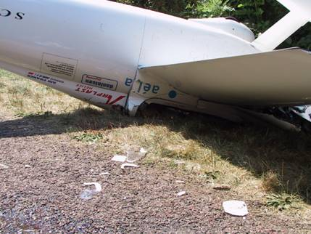
Emergency Summary
You Will Have Emergencies!
  There Aren’t Enough People for them to Always Happen to “The Other Guy”
  Think Ahead and Rehearse Your Emergency Actions Before Takeoff – Be Prepared!
  Declare Mayday Immediately!
Recognize the Potential For Emergencies and Take Steps to Mitigate Risks
  Learn from Other People’s Experiences
Make Sure You and Your Equipment Are In Top Condition for Each Flight
  Inspect After Each Run
  Use Checklists
  Use Aviation Grade Equipment and Approved Maintenance Practices
  Arrive at Roswell Confident in Your Ability and Equipment

Slide 103
Pitts Accident Investigation Report Summary
Compiled for Race Pilot Training
Pylon Racing Seminar
20 Fatal Events in last 40 years
1985-2025
S-1 & S-2

Slide 104
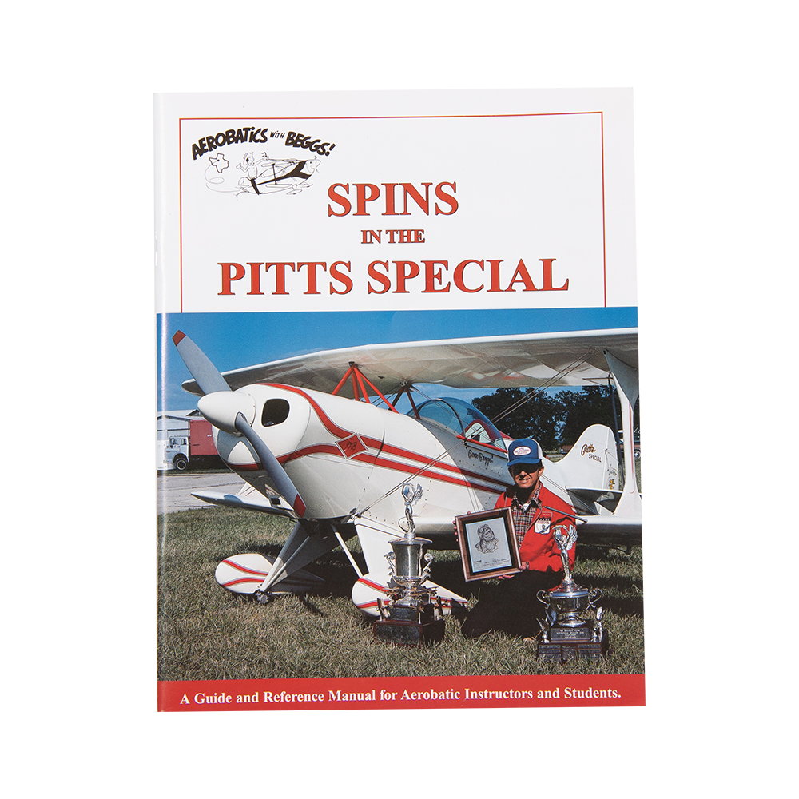
Pitts Accident Investigation Summary
20 Fatal Accidents in the USA since 1985
0 Mechanical Failures
90% Loss of Control (Low Level Aerobatics and Stall/Spin)
1 Midair, S-2 cut the tail off a 172. S-2 Landed.
1 Fuel Exhaustion, impact zone indicative of stall/spin
Spins in the Pitts Special

Slide 105
Racing Logistics
Credentials and Ramp Security
Ground Runs
Towing/Taxiing
Fuel, Oil, & Spark Plugs
Spare Parts/Hardware/Tools
Daily Briefings

Slide 106
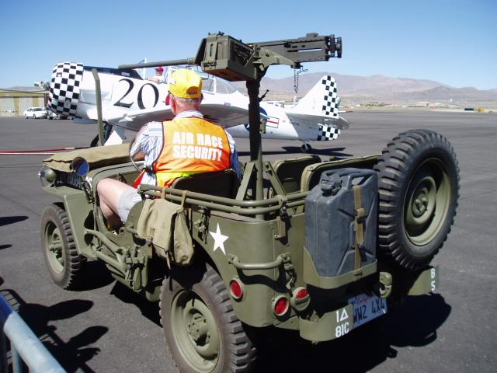
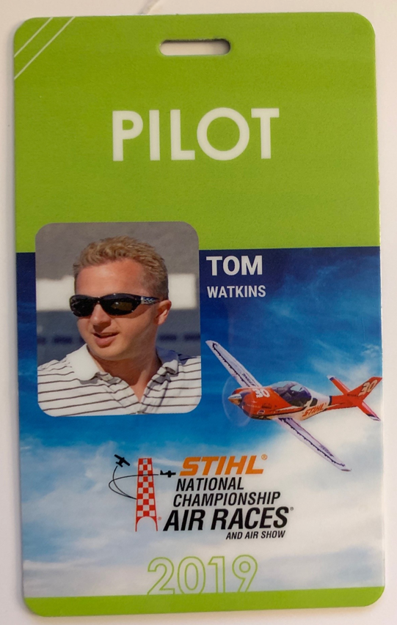
Wear Your Credentials to Avoid a Hassle
Pilot ID and Crew Wrist Bands to Enter Pit from Parking Lot
Wrist Bands Plus Crew Line arm bands (for Crew) to Pass Crowd Line

Slide 107
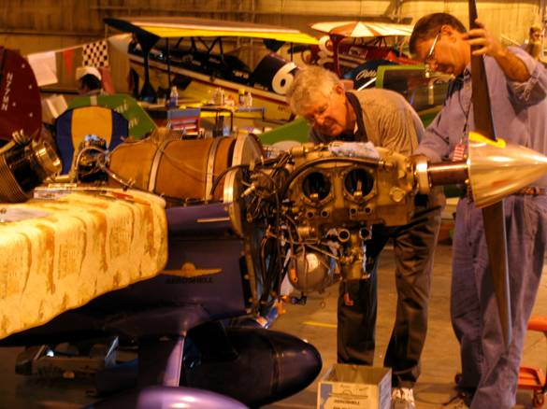
Ground Runs
Always Tow Out to Flight Line Past “Prop Turn” Line
Perform Ground Runs After
  Oil Change to Verify No Leaks
  Carburetor Work
  P-Lead Work
  Cylinder/Piston Work
  Prop or Spinner Change
  Spark Plugs Changed/Regapped
  Timing Adjusted
Make Sure Everything Works BEFORE You Get To the Starting Line!

Slide 108
Towing/Taxiing
Use Wingtip Walkers to Prevent Injury and Damage
Observe The No Prop Turn Line Religiously
Taxi Back is Very Helpful During Practice/Qual
Dollies Reduce Risk of Damage During Towing

Slide 109
Fuel, Oil, & Spark Plugs
Refuel After Each Run/Race on the Way Back to Hangar
  Dump Used Oil in appropriate disposal repository
  Use Separate Barrel for Solvents
  Get Plugs Cleaned and Checked prior to the event

Slide 110
Daily Briefings
Normally Briefings are at 7:00 AM or as published
You Must Attend the Briefing if You Want to Fly That Day
  No Surrogates
  No Mercy for Oversleeping
  No excuses
Normally Mandatory Briefing on Sunday AM Before Race Week starts
  Be sure you Know the Schedule and Requirements
Class Presidents Debrief at 1700 Each Day
  Voice Your Issues Through the President
Don’t Miss Flying Because you Missed the Briefing

Slide 111
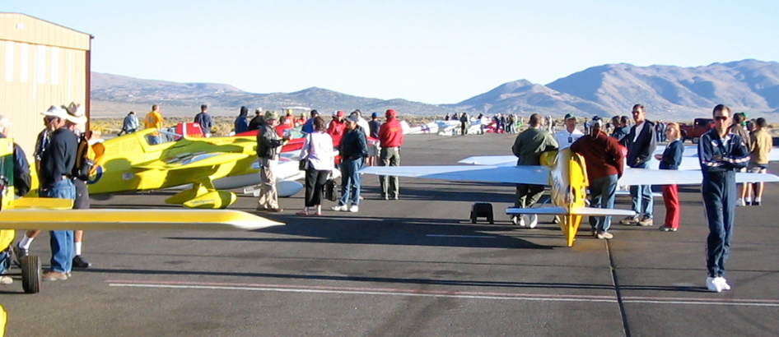
Social Skills on the Runway/Ramp
Competition Starts on Push Out!
  Everyone Will Get to Fly – Don’t Be Pushy
Limit Practice Laps
  Especially After You Are Qualified
Do Not Damage Your Buddy’s Plane!
  Avoid Canopy FOD and Nicks From Prop Blast

Slide 112
Prize Money
Offsets Some Financial Costs of Racers
Proportional to Finishing Position (points)
Earned Progressively from Qual to Final
Distribution Provided in Advance to Racers & RARA
Your Fines Distributed to Other Racers

Slide 113
Prize Money
Progressive Purse Payout
1st Place Gold no more than 10% of total purse
Last Place No less than 1.5%
Last place Gold > First place Silver
Total purse value changes for every event
Direct from RARA
Lucky if it covers your insurance. Not a big payout

Slide 114
BARC Organization
Formal Structure
Identities/Duties
Contest Committee

Slide 115
BARC Organization
President
Executive Committee
Vice Pres.
Sec/Tres
Board of Directors
Tech Dir.
Operations Dir.
Procedure Rules Chair
All These Positions are Filled by Election IAW Bylaws*
*Bylaws available online

Slide 116
Identities & Duties
President – 2 yr
Represents BARC to RARA
Presides at All Meetings of BoD
General Supervision of BARC Corporation
Communicate with Directors
Signs BARC Contracts Authorized by the BoD
Vice President – 2 yr
Supports President/Acts in His Absence
Performs Duties as Assigned by BoD

Slide 117
Identities & Duties
Sec/Treas - 2 yrs
Provides Agendas for All Meetings
Documents Meetings with Minutes
Provides Notices on Behalf of BARC Corp
Keeps Financial Records/Accounts of Corp.
Establishes Purse Distribution
Maintains Membership Database
Receives Income and Makes Payments
Conducts Nominations/Elections/Rule Voting
Submits Corporate Tax Returns
Support Your All-Volunteer Organization and Step Up to Run at Election Time

Slide 118
Identities & Duties
Ops Director -1 yr
Responsible for BARC Flight Ops at Races
Clarifies Race Rules
Responsible for Race Parings/Grid Arrangement
Responsible for Pylons, Flags, Radios
May Disallow Racers to Fly if Unfit (e.g. Hung Over, Sick, etc.) and Withdraw a Racing License

Slide 119
BARC Pylon Air Racing
Summary
Technical Requirements Defined for Airplane, Engine, & Pilot
Previous Emergency Events Provide Valuable Lessons for Us
Come to race with Top Equipment, Excellent Skills, and a Safety-Oriented Attitude and You’ll Have A Great Time!

Slide 120
PRS 2025 Plan
Fam Rides where able
Flight Ops (3 rookies max on course)
Solo launches (Static)
Simulated Race Start
Certified Racers need 3 laps
Rookie Evaluations w/ maneuvers
Pylon Tour (if possible)
Guest Speakers
Airport familiarization

